Slide 1
Binary Tag Synchronization

Slide 2
Binary Tag Synchronization
Problem
Solution

Slide 3
Problem
We need to align our data streams!

Slide 4
Matching up data
When we’re recording multiple signals, how do we measure the time between events if the events occur in two different signals?
S1
?
S2

Slide 5
Matching up data
Ideally, the two signals are recorded by the same DAQ
The DAQ ensures the signals are sampled simultaneously
Data is saved together in the same file, allowing us to easily measure the relative time of events in different signals.
S1
S2

Slide 6
Clock trigger signal
In practice, it is often necessary to use multiple DAQs for different signals.
But we still need to be able to align signals during analysis.
A common strategy is to trigger the DAQs from a common clock signal, ensuring that the Nth sample in DAQ 1 corresponds exactly to the Nth sample in DAQ2.
S1
C
S2

Slide 7
Clock sync signal
Sometimes the data needs to be sampled at different rates, so we can’t trigger the two DAQs with the same clock signal
But we can still record a clock pulse in both DAQs.
The clock pulses can be used to establish a correspondence between samples in the two data streams.
S1
C
S2

Slide 8
But what if…
This can work well if everything works perfectly!
What if one of the DAQs doesn’t start right away?
S1
C
S2

Slide 9
But what if…
This can work well if everything works perfectly!
What if one DAQ drops samples?
Or a whole chunk, when a file is deleted?
S1
C
S2

Slide 10
But what if…
What if the signals are being recorded for a long time?
Then to determine how far apart the events are, we need to count potentially hundreds of millions of clock pulses!
This can be computationally intensive.
S1
C
… 100s of millions
of pulses later
S2

Slide 11
Solution
Binary Synchronization Tags

Slide 12
Tag sync signal
We need a clock signal where the clock pulses can be identified without counting from the beginning of the data stream
Solution: Make clock pulses uniquely identifiable!
Then we can align two data streams even if
They are sampled at different rates
They start at different times
Data is missing from one or more streams
S1
ID=17
ID=18
ID=19
C
S2
ID=17
ID=18
ID=19

Slide 13
Tag Synchronization
Each tag is essentially a binary timestamp.
Start separator
End
separator
TaggingPeriod
Pulse Width
Tag Data
(tag index
in binary)
Tag Data Copy
(tag index in
binary in
reverse for
integrity check)
TagMarkerDuration
Start Marker
End Marker

Slide 14
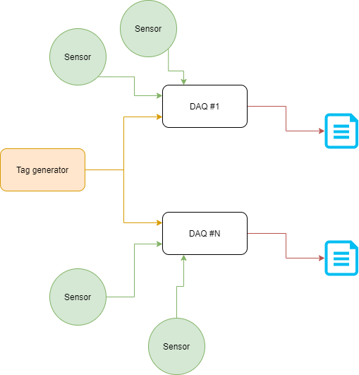
Tag Synchronization
…

Slide 15
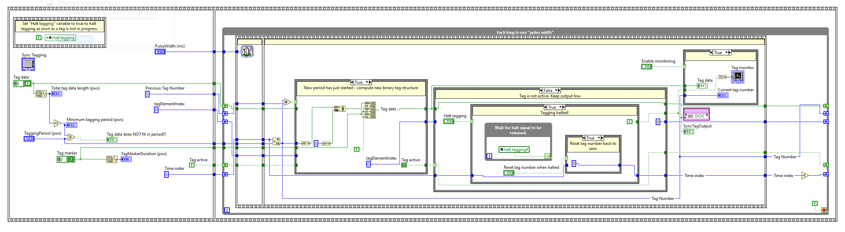
Tag Synchronization
Currently implemented in LabVIEW, could be easily ported to other languages.

Slide 16
Tag Synchronization
Example of real-life tag synchronization of two data streams
Top row is tag signal recorded by FPGA
Bottom rows are tag signal recorded by Phantom camera Tags are used to align the two data streams
In this case, tags are also generated by FPGA

Slide 17
Tag Synchronization Summary
How do we align multiple data streams in the face of real world recording complexities and failures?
Generate a stream of uniquely identifiable binary tags
Record the binary tags on all of your DAQs along with other data
Post-hoc alignment of streams is then possible
Without counting from start of streams
Despite different sampling rates
Despite different start times
Despite missing data

